Slide 1
Module - 3
Big Data
Business Intelligence
Data Warehousing
Data Mining
Data Visualization
Dr. S. NANDAGOPALAN

Slide 2
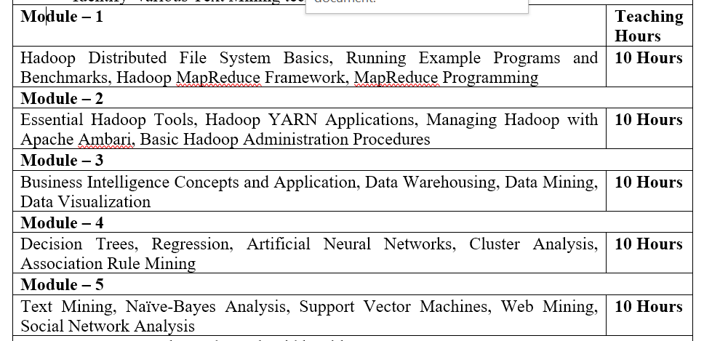
Syllabus : BDA :15CS82

Slide 3
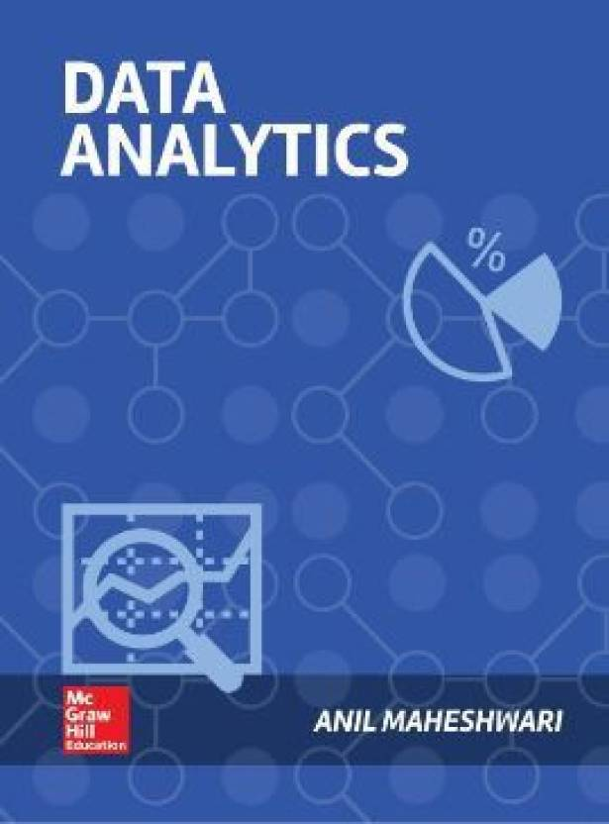
Text Book

Slide 4
Agenda
What is Big Data?
Overview
Business Intelligence Concepts and Applications
Data Warehousing
Data Mining
Data Visualization
Summary

Slide 5
Big Data

Slide 6
What is Big Data?
Collection of data sets so large and complex that it becomes difficult to process using on-hand database management tools.
Challenges include capture, curation, storage, search, sharing, analysis, and visualization
Additional information is derivable from analysis of a single large set of related data, as compared to separate smaller sets
to spot business trends, determine quality of research, prevent diseases, link legal citations, combat crime, and determine real-time roadway traffic conditions

Slide 7
Business Issues
How to use generated data as a strategic asset in real-time, to identify opportunities, thwart threats and achieve operational efficiencies?
How to organize the business to not get buried in high volume, velocity and variety of data?
How to design a ‘Digital Business Strategy’ around digital assets and capabilities?

Slide 8

Growth of Big Data

Slide 9
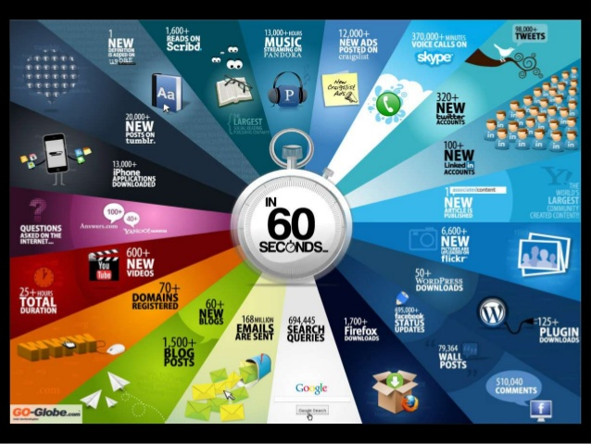

Slide 10
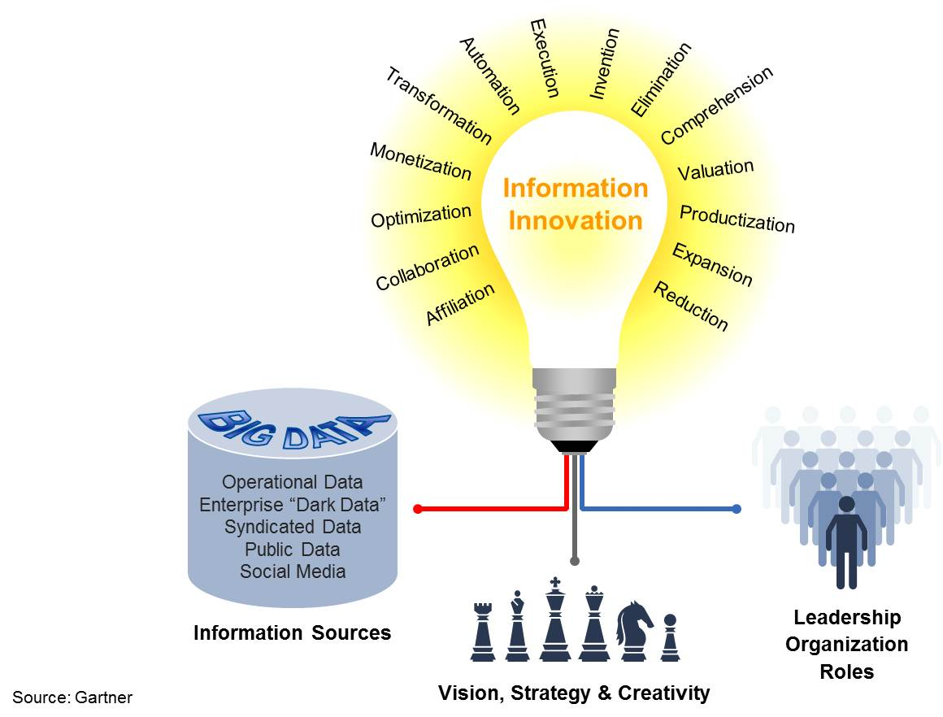
Innovation
Innovation is defined as the process of making an idea or invention into a good or service that creates value and/or for which customers will pay
innovation example: The electronics company LG introduced a new type of screen that is flexible enough to roll up like a newspaper.

Slide 11
Module Overview

Slide 12
Learning Objectives
Understand the Business Intelligence and Data Mining Cycle that brings the business and technologies elements together to deliver powerful business advantage
Learn about Business intelligence, its tools and purpose
Discover what are patterns, the various types of patterns, and the process of discovering patterns
Understand the data processing chain, which includes the entire life cycle of data, from data generation to its consumption.
Learn in brief each of the components of the data processing chain – data modeling, data warehousing, data mining, and data visualization
Process a simple example data set through the full data processing chain
Learn about datafication, and the various types of data

Slide 13
BI Cycle
Business generates data. Data is Mined to produce Insights & Intelligence
Intelligence is fed back into business. Business performance improves; more data …
Business
Intelligence
Data
Mining

Slide 14
BIDM Cycle
Business is the act of doing something productive to serve someone’s needs, and thus earn a living and make the world a better place.
Business activities are recorded on paper or using electronic media, and then these records become data. There is more data from customers’ responses and on the industry as a whole.
All this data can be analyzed and mined using special tools and techniques to generate patterns and intelligence, which reflect how the business is functioning.
These ideas can then be fed back into the business so that it can evolve to become more effective and efficient in serving customer needs. And the cycle continues on.

Slide 15
Business Intelligence
A set of tools to inform the business about things it should know
Includes tools for gathering, analyzing and presenting data

Slide 16
Pattern Recognition
A pattern is a design or model that helps grasp something.
Hard patterns e.g. sun rises in east
Soft patterns e.g. Pareto principle
General, Accurate, and Simple (GAS) model e.g. E=MC2
Most models will be good on 2 out of 3
80% of work is completed by 20% of a team
General
80% of software problems are caused by 20% of bugs
80% of customers only use 20% of software features
Accurate
Simple

Slide 17
Nature of Patterns
Temporal patterns, related to time
E.g. rain follows lightening and thunder
Spatial patterns, related to layout
Tech industry in SFO; Finance in NYC
Functional patterns, related to functional organizing
Classroom layout; structure of any software
Ways to get data to discern patterns
From intuitive personal experience
From data analysis

Slide 18
Data Management Chain
Data
Data Base
Data Warehouse
Data Mining
Data Visualization

Slide 19
Data
Everything that is recorded is data
Exponential growth; doubling every 12-18 months
Many sources, e.g. stories, operations, machines
Many media e.g. electronic, paper
Types of numeric data
Nominal, e.g. red, green, blue
Ordinal, e.g. high, medium, low
Interval, e.g. 7 on a 1-10 scale
Ratio, e.g. height is 69, height is 170
Unstructured data, e.g. video, audio, images, text
Data about data (metadata)
Public vs private data

Slide 20
Database and data modeling
Data is organized in tables
Tables relate to entities and relationships among entities
Entities are nouns like Doctor, Patient
Relationships are verbs like ‘Treats’
Data tables can be managed using SQL language in simple declarative mode
Doctor
Treats
Patient

Slide 21
Data Warehousing
Organize, ‘rectangularized’, cleansed data for structured reporting and data mining
Data is Extracted from many sources, Transformed to meet business needs, and Loaded into DW
Data Sources
Operations
ERP systems
Legacy systems
Point of Sale
RFID systems
Web usage
ExternalSources
Suppliers
Customers
Government
Data Transformation
- Select Data
Extract Data
Cleanse data
Compute Data fields
Integrate Data
Load data
Data Mart or Warehouse
Rectangularized data ready for analysis
One for each department, Or
One for the whole enterprise
Accessing users & applications
- OLAP tools
- Reporting Tools
- Dashboards
- Queries
- Mobile Devices
- Data Mining
- Custom apps

Slide 22
Database vs Data Warehouse
Function | Database | Data Warehouse
Purpose | Data stored in databases can be used for many purposes including day-to-day operations | Data in DW is cleansed data useful for reporting and analysis
Granularity | Highly granular data including all activity and transaction details | Lower granularity data; rolled up to certain key dimensions of interest
Complexity | Highly complex with dozens or hundreds of data files, linked through common data fields | Typically organized around a large fact tables, and many lookup tables
Size | Database grows with growing volumes of activity and transactions. Old completed transactions are deleted to reduce size. | Grows as data from operational databases is rolled-up and appended every day. Data is retained for long-term trend analyses
Architectural choices | Relational, and object-oriented, databases | Star schema, or Snowflake schema
Data Access mechanisms | Primarily through high level languages such as SQL. Traditional programming access DB through Open DataBase Connectivity (ODBC) interfaces | Accessed through SQL; SQL output is forwarded to reporting tools and data visualization tools

Slide 23
Data Mining
Art and science of discovering useful novel patterns from data
E.g. seasonality of products
E.g. customer segments with unique needs
Supervised learning (right answer is known)
Decision-making, e.g. approve loan or not
Predictive patterns, e.g. sales next month
Exploratory patterns (no right answer)
Clusters, e.g. customer segments
Association rules, e.g. products that sell together

Slide 24
Data Mining – Major Techniques
Supervised Learning (Predictive ability based on past data) | Classification – Machine Learning | Decision Trees SVMs
 |  | Neural Networks
 | Classification - Statistics | Regression; Dimension Reduction
Unsupervised Learning (Exploratory analysis to discover patterns) | Clustering Analysis | K-Means
 | Association Rules | Apriori

Slide 25
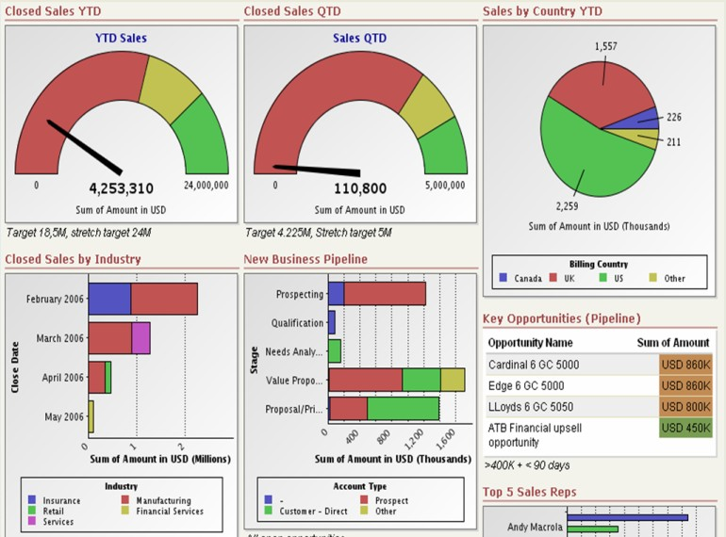
Data Visualizing
Help understand data easily, and drill down
Graphs, Dashboard, Animation, etc.

Slide 26
Operations Database is very granular and records every detail of every transaction
Movies Transaction Database
Order # | Date sold | Product name | Location | Total value
1 | April 2013 | Monty Python | US | $9
2 | May 2013 | Gone With the Wind | US | $15
3 | June 2013 | Monty Python | India | $9
4 | June 2013 | Monty Python | UK | $12
5 | July 2013 | Matrix | US | $12
6 | July 2013 | Monty Python | US | $12
7 | July 2013 | Gone With the Wind | US | $15
8 | Aug 2013 | Matrix | US | $12
9 | Sept 2013 | Matrix | India | $12
10 | Sept 2013 | Monty Python | US | $9
11 | Sept 2013 | Gone With the Wind | US | $15
12 | Sept 2013 | Monty Python | India | $9
13 | Nov 2013 | Gone With the Wind | US | $15
14 | Dec 2013 | Monty Python | US | $9
15 | Dec 2013 | Monty Python | US | $9

Slide 27
Data Warehouse rolls the data up to dimensions of analytical interest
Movies Sales Data Warehouse
Row# | Qtr sold | Product name | Total value
1 | Q2 | Gone With the Wind | $15
2 | Q2 | Monty Python | $30
3 | Q3 | Gone With the Wind | $30
4 | Q3 | Matrix | $36
5 | Q3 | Monty Python | $30
6 | Q3 | Matrix | $36
7 | Q4 | Gone With the Wind | $15
8 | Q4 | Monty Python | $18

Slide 28
Analytics: Simple cross-table analysis brings out new insights
Matrix is a Seasonal movie
Movies Sales by Quarters – Cross-tabulation
Q/Product | Gone With the Wind | Matrix | Monty Python | Total Sales
Q2 | $15 | 0 | $30 | $45
Q3 | $30 | $36 | $30 | $96
Q4 | $15 | 0 | $18 | $33
Total Sales | $60 | $36 | $78 | $174
Highest income
quarter is Q3
Monty Python is the
highest selling movie

Slide 29
Datafication; Data Types
Datafication means everything is being recorded and stored, as the cost of capturing and storing data is decreasing
There are many types of data:
Nominal e.g. names like red, green
Ordinal e.g. levels like high, medium, low
Interval, e.g. range of Liking from 1-5
Ratio, i.e. all real numbers
Unstructured, e.g. video, audio, graphs etc

Slide 30
Business Intelligence Concepts and Application

Slide 31
Learning Objectives
Understand the concept of Business Intelligence, and its role in decision-making
Understand the two major types of decisions
Understand the type and range of tools for Business Intelligence
Appreciate the wide range of applications of Business Intelligence across industry domains

Slide 32
BIDM cycle
Business
Intelligence
and
Data
Mining

Slide 33
BIDM
Business intelligence (BI) is an umbrella term that includes a variety of IT applications that are used to analyze an organization’s data and communicate the information to relevant users. Its major components are
Data warehousing, data mining, querying, and reporting
The nature of life and businesses is to grow. Information is the lifeblood of business.
Businesses use many techniques for understanding their environment and predicting the future for their own benefit and growth.
Decisions are made from facts and feelings

Slide 34
Khan Academy—BI in Education
Khan Academy is an innovative nonprofit educational organization that is turning the K-12 education system upside down.
It provides short YouTube based video lessons on thousands of topics for free. It shot into prominence when Bill Gates promoted it as a resource that he used to teach his own children.
With this kind of a resource, classrooms are being flipped— that is, students do their basic lecture-type learning at home using those videos, while the class time is used for more one-on-one problem solving and coaching.

Slide 35
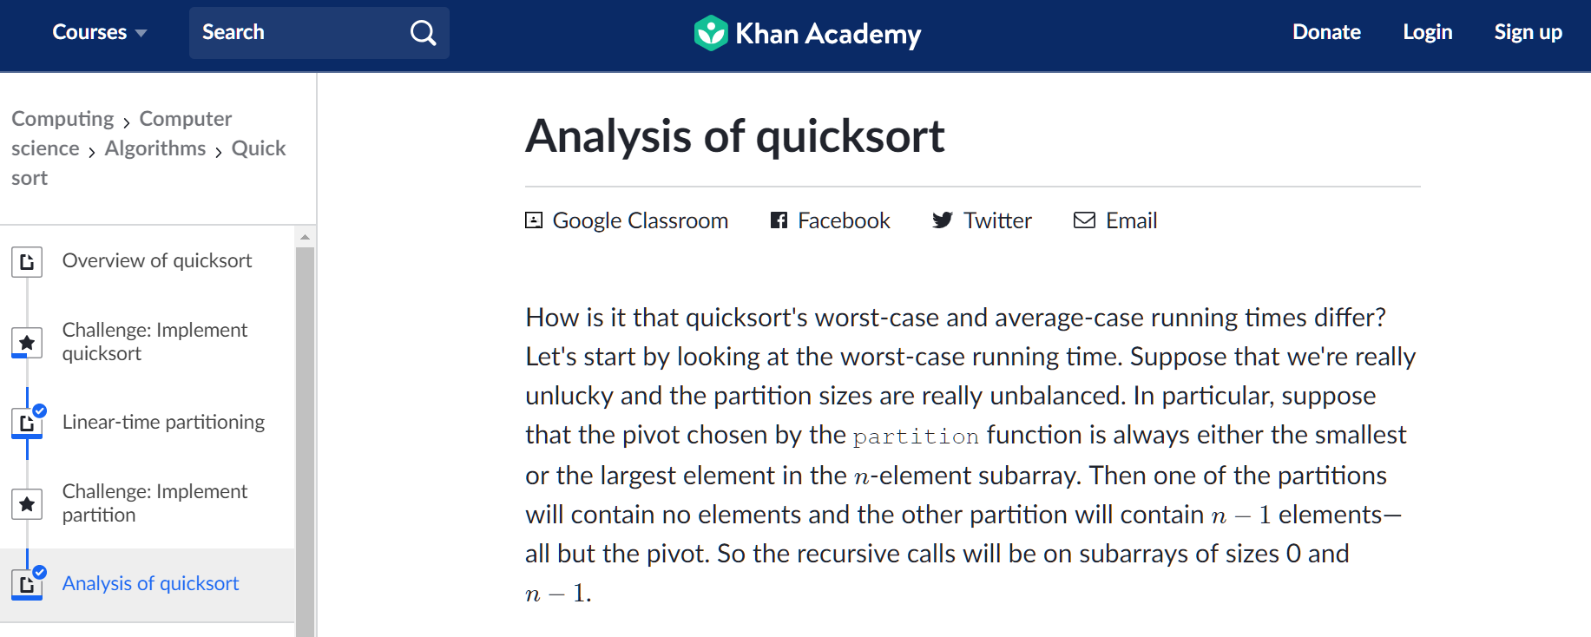
Khan Academy

Slide 36
Advantages
Khan Academy has developed tools to help teachers get a pulse on what is happening in the classroom.
Teachers are provided a set of real-time dashboards to give them information from the macrolevel
“How is my class doing on geometry?”
to the micro level
“How is Jane doing on mastering polygons?”

Slide 37
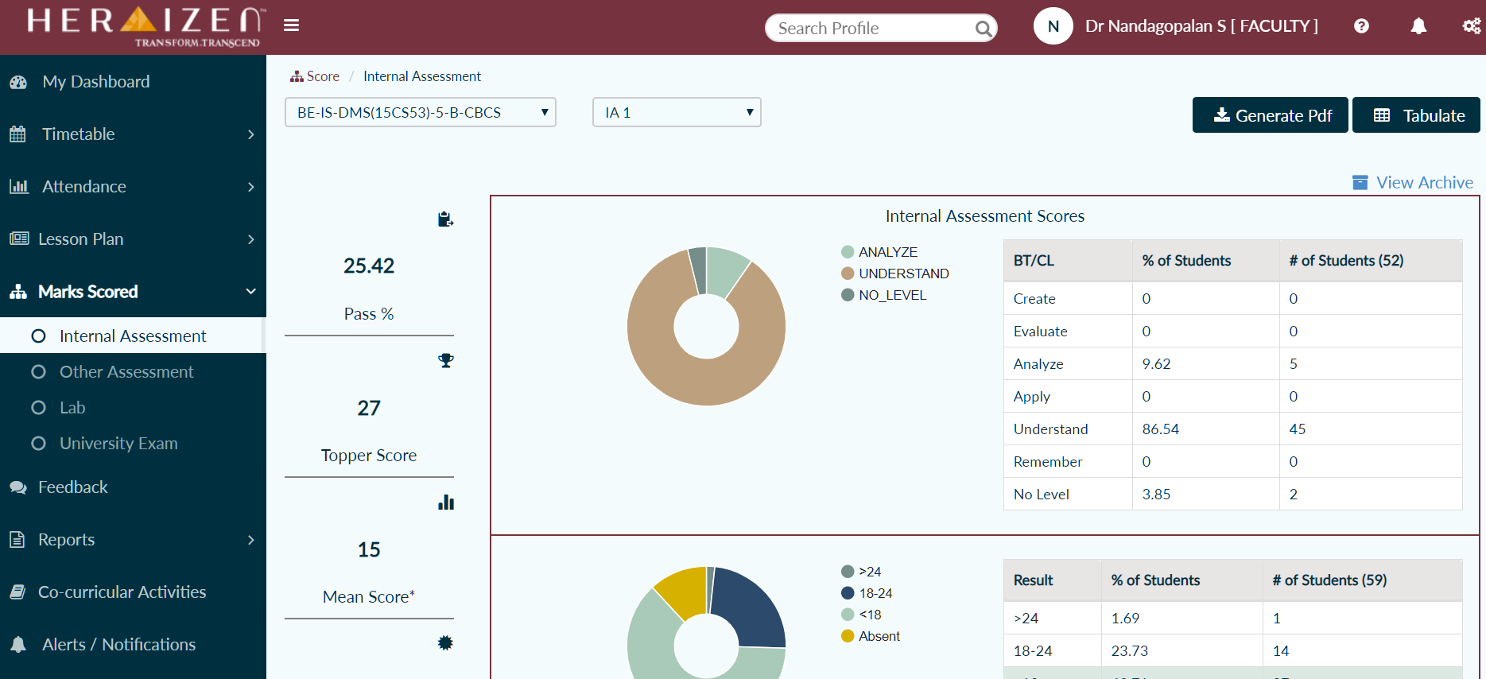
Vemana IT ERP

Slide 38
BI for Better Decisions
The future is inherently uncertain. Risk is the result of a probabilistic world where there are no certainties and complexities abound.
People use crystal balls, astrology, palmistry, ground hogs, and also mathematics and numbers to mitigate risk in decision-making.
The goal is to make effective decisions, while reducing risk. Businesses calculate risks and make decisions based on a broad set of facts and insights.

Slide 39
Contd…
T﻿he speed of action has risen exponentially with the growth of the Internet and Mobile phones.
Decisions can be made anytime, anywhere due to mobility.
Unfavorable comment about the company and its products on social media should not go unaddressed for long – Sentiment Analysis.

Slide 40
Types of Business Decisions
Strategic Decisions
impact the direction of the company
The decision to reach out to a new customer set would be a strategic decision.
Operational Decisions
Learning from past decisions to create efficient models for future - classification
Updating an old website with new features will be an operational decision.
Creating a decision-tree for standardizing loan approval process

Slide 41
BI Tools
BI tools can range from very simple tools that could be considered end-user tools, to very sophisticated tools that offer a very broad and complex set of functionality
MS Excel can be an effective tool.
A dashboarding system, such as IBM Cognos or Tableau, can offer a sophisticated set of tools for gathering, analyzing, and presenting data.
At the user end, modular dashboards can be designed and redesigned easily with a graphical user interface.
The back-end data analytical capabilities include many statistical functions.

Slide 42
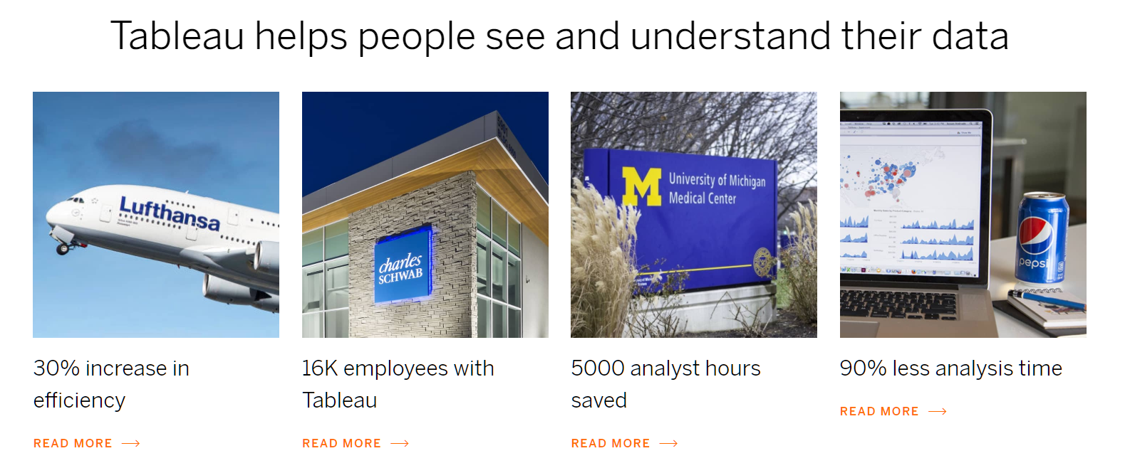
Tableau

Slide 43
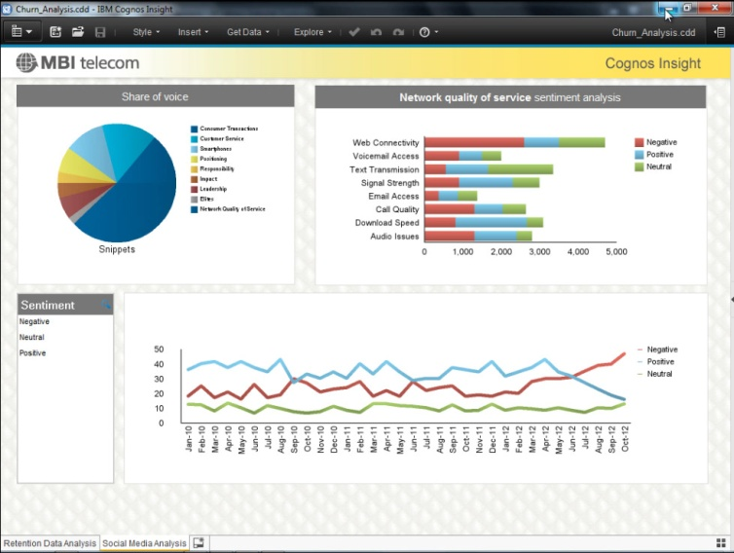
Sample Executive Dashboard

Slide 44
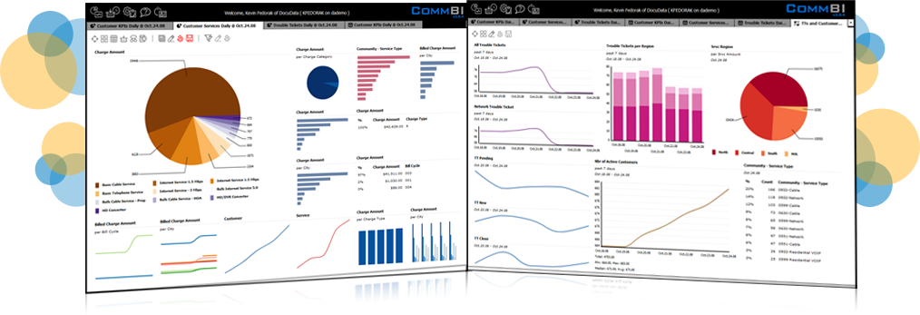
Contd.

Slide 45
BI Skills
Broad knowledge of the domain
Selecting the right problem to solve
Creating imaginative solutions
Persistence and skill in analyzing data

Slide 46
BI Applications
Needed in almost all industries
Customer relationship management
Health, Education, Government
Retailing and Logistics
Banking, Insurance, Financial services
Manufacturing
Telecom
Needed for many functions
Customer relationship management
Marketing
Operations

Slide 47
Customer Relationship Management
Maximize return on marketing campaigns
marketing messages
Improve customer retention (churn analysis)
Offer discounts
Maximize customer value (cross-, up-selling)
Offer new products and solutions
Identify and treat most valued customers
Segmenting valuable customers
Manage Brand Image
Respond to social media reviews thru Sentiment Analysis

Slide 48
Health Care and Wellness
Diagnose disease in patients
Accurately diagnosing cases of cancer or diabetes can be a matter of life and death for the patient
IBM Watson, absorb all the medical research to date and make probabilistic diagnoses in the form of a decision tree, along with a full explanation for their recommendations
Treatment Effectiveness
Wellness management
keeping track of patient health records, analyzing customer health trends
Identify and prevent fraudulent activities
Public Health management
By using effective forecasting tools and techniques, governments can predict disease in certain areas in real time.

Slide 49
Education
Students Enrolment
Colleges can develop models of what kinds of students are attracted to the college, and then reach out to those students.
Course Offerings
Develop models of which new courses are likely to be more popular with students.
Alumni pledges
develop predictive models of which alumni are most likely to pledge financial support to the school

Slide 50
Retail and Logistics
Optimize inventory levels at different locations
Predicting sales trends dynamically can help retailers move inventory to where it is most in demand.
Improve the store layout and sales promotions
A market basket analysis can develop predictive models to increase sales
Optimize logistics by predicting seasonal effects
Understanding which products are in season in which market can help retailers dynamically manage prices
Minimize losses due to limited shelf life

Slide 51
Banking
Automate the loan application process
Decision models
Detecting fraudulent transactions
if money is being transferred to an unrelated account for the first time, it could be a fraudulent transaction.
Maximize customer value (cross-, up-selling)
Selling more products and services to existing customers is often the easiest way to increase revenue.

Slide 52
Financial Services
Forecasting claims
the insurer can plan for losses and manage resources and profits effectively when natural losses happen – earthquake, tsunami, etc.
Rate planning
Pricing an insurance rate plan requires covering the potential losses and making a profit
Micro-marketing
Optimize marketing to specific customers
Fraud management
Patterns can be identified as to where and what kinds of fraud are more likely to occur

Slide 53
Manufacturing
Product quality management
Predict/prevent machinery failures
Identify anomalies in production systems to optimize the use manufacturing capacity

Slide 54
Telecom
Churn Management
Marketing and Product creation
Network failure management
Fraud management

Slide 55
Government
Law enforcement
Social behavior is a lot more patterned and predictable than one would imagine.
For example, Los Angeles Police Department (LAPD) mined the data from its 13 million crime records over 80 years and developed models of what kind of crime going to happen when and where
Scientific research
Protein folding (microbiology), nuclear reaction analysis (subatomic physics), disease control (public health)

Slide 56
Data Warehousing

Slide 57
Learning Objectives
Understand the concept of Data Warehouse, and its role in data analytics
Appreciate the design choices in developing a DW
Understand the top-down and bottom approaches of developing a DW and their various advantages
Understand the architecture of a DW
Understand the type and range of data sources,
Understand the Extract-Transform-Load (ETL) processes
Understand the star schema for organizing the DW
Appreciate the key best practices for designing an effective DW

Slide 58
DWH Definition
A Data warehouse (DW) is an organized collection of integrated, subject-oriented databases designed to support decision support functions.
organized at the right level of granularity (usually some unit of time)
provides clean enterprise-wide data in a standardized format for reports, queries and analysis.
has to be constantly kept up-to-date to be useful
Has clear Metadata (Data about data)
A DW is physically and functionally separate from an operational transactional database.
Creating a DW for analysis and queries represents significant investment in time and effort.

Slide 59
Benefits of DW
Support business reporting and data mining activities
Facilitate distributed access to up-to-date business knowledge for departments and functions
Simplifies data access and allows end users to perform extensive analysis.
Present a competitive advantage by facilitating decision making and helping reform business processes
Enables a consolidated view of corporate data, all cleaned and organized.
Enhance customer service and satisfaction
Enhances overall IT performance by not burdening the operational databases used by ERP and other systems.

Slide 60
What is a DWH?
Definition: Data warehouses generalize and consolidate data in multidimensional space.
Construction of DW involves: data cleaning, data integration, and data transformation
Provide OLAP tools for interactive analysis of data
Provide architectures and tools for systematically organize, understand, and use their data to make strategic decisions
Using OLAP, businesses can analyze data in all manner of different ways, including budgeting, planning, simulation, data warehouse reporting, and trend analysis
Example: Using MOLAP, a sales manager can create a report sorted by account manager, arranged according to client names, and identifying all generated revenue associated with the salesperson’s accounts within a given time period

Slide 61
DWH…
Most important assets of any organization is its information.
This asset is kept in two forms:
the operational systems of record - where the data is put in
the data warehouse - where we get the data out.
Users of a data warehouse almost never deal with one row at a time.
They require hundreds or thousands of rows to be searched and compressed into an answer set.

Slide 62
Goals of DWH
“We have mountains of data in this company, but we can’t access it.”
“We need to slice and dice the data every which way.”
“You’ve got to make it easy for business people to get at the data directly.”
“Just show me what is important.”
“It drives me crazy to have two people present the same business metrics at a meeting, but with different numbers.”
“We want people to use information to support more fact-based decision making.”

Slide 63
Goals…
The data warehouse must make an organization’s information easily accessible – slice & dice
The data warehouse must present the organization’s information consistently – careful assembly of data
The data warehouse must be adaptive and resilient to change – changes are bound to happen
The data warehouse must be a secure bastion that protects our information assets
The data warehouse must serve as the foundation for improved decision making
The business community must accept the data warehouse if it is to be deemed successful

Slide 64
Key Terms
Subject-Oriented - Organized around major subjects, such as customer, product, sales
Integrated - Constructed by integrating multiple, heterogeneous data sources like relational databases, flat files, on-line transaction records
Time Variant - provide information from a historical perspective (e.g., past 5-10 years)
Nonvolatile - Does not require transaction processing, recovery, and concurrency control mechanisms. Requires only two operations in data accessing: initial loading of data and access of data

Slide 65

OLTP Vs. OLAP

Slide 66
Data Warehouse types
Enterprise data warehouse (EDW): A data warehouse for the enterprise.
Represents a Top-down approach
Data Mart: A departmental data warehouse
Represents a Bottom-up approach

Slide 67
DW Development Approaches
(Kimball Approach) (Inmon Approach)
 | Functional Data Mart | Enterprise Data Warehouse
Scope | One subject or functional area | Complete enterprise data needs
Value | Functional area reporting and insights | Deeper insights connecting multiple functional areas
Target organization | Decentralized management | Centralized management
Time | Low to medium | High
Cost | Low | High
Size | Small to medium | Medium to large
Approach | Bottom up | Top down
Complexity | Low (fewer data transformations) | High (data standardization)
Technology | Smaller scale servers and databases | Industrial strength

Slide 68
A Conceptual Framework for DW
Data Sources
Operations
ERP systems
Legacy systems
Point of Sale
RFID systems
Web usage
External Sources
Suppliers
Customers
Government
Accessing users & applications
- OLAP tools
- Reporting Tools
- Dashboards
- Queries
- Mobile Devices
- Data Mining
- Custom apps
Data Transform-ation
- Select Data
Extract Data
Cleanse data
Compute Data fields
Integrate Data
Load data
Data Mart or Warehouse
Rectangular-ized data ready for analysis
One for each department, Or
One for the whole enterprise

Slide 69
DW Architecture Considerations
Which database management system (DBMS) should be used?
Will parallel processing and/or partitioning be used?
Will data migration tools be used to load the data warehouse?
What tools will be used to support data retrieval and analysis?

Slide 70
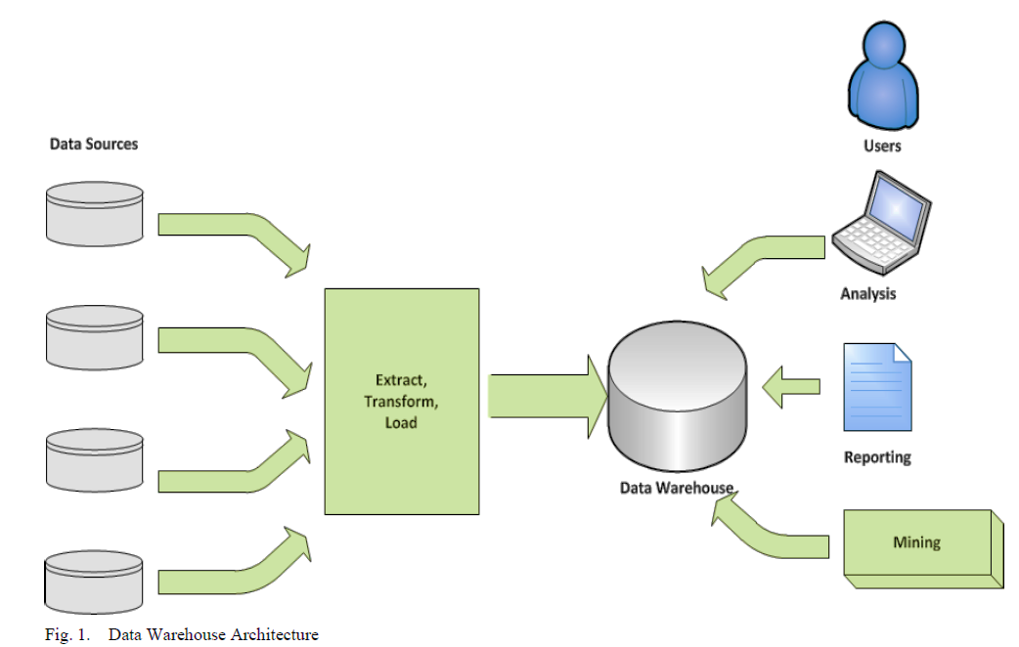
DWH Architecture

Slide 71
Data Integration and the Extraction, Transformation, and Load (ETL) Process
Extraction, Transformation, and Load (ETL) process
Temporary
Data Staging Area
Operational Systems
Enterprise
Data Warehouse
Legacy Systems
Extract
Transform/Cleanse /Compute
Load
Department
Data Mart
External Data

Slide 72
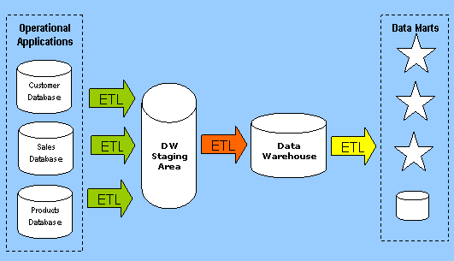
Data Warehousing Environment

Slide 73
Dimensional Modeling
A data warehouse is based on a multidimensional data model which views data in the form of a data cube
A data cube, such as sales, allows data to be modeled and viewed in multiple dimensions
Dimension tables, such as item (item_name, brand, type), or time(day, week, month, quarter, year)
Fact table contains measures (such as dollars_sold) and keys to each of the related dimension tables

Slide 74
Cube: A Lattice of Cuboids
all
0-D(apex) cuboid
time
item
location
supplier
1-D cuboids
time,location
item,location
location,supplier
2-D cuboids
time,supplier
item,supplier
time,location,supplier
3-D cuboids
time,item,supplier
item,location,supplier
4-D(base) cuboid

Slide 75
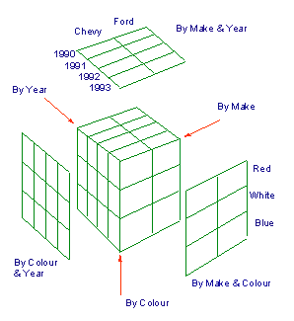
Example
A d-dimensional base cube is associated with 2^{d} cuboids.
Each cuboid represents a unique view of the data at a given level of granularity

Slide 76
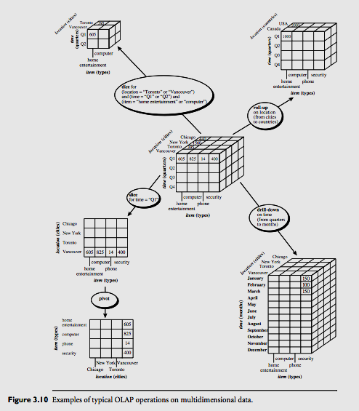
OLAP Manipulation

Slide 77
Dimensional Modeling…
Fact Table
A fact table is the primary table in a dimensional model where the numerical performance measurements of the business are stored.
We use the term fact to represent a business measure.
We can imagine standing in the marketplace watching products being sold and writing down the quantity sold and dollar sales amount each day for each product in each store
The most useful facts in a fact table are numeric and additive.

Slide 78
Fact Table…
All fact tables have two or more foreign keys, as designated by the FK notation that connect to the dimension tables’ primary keys.
For example, the product key in the fact table always will match a specific product key in the product dimension table.
When all the keys in the fact table match their respective primary keys correctly in the corresponding dimension tables, we say that the tables satisfy referential integrity.
The fact table is accessed via the dimension tables joined to it.
The fact table itself generally has its own primary key made up of a subset of the foreign keys. This key is often called a composite or concatenated key.
Fact tables express the many-to-many relationships between dimensions in dimensional models.

Slide 79
Dimension Tables
Dimension tables have many columns or attributes. These attributes describe the rows in the dimension table. It is defined with a single PK.
Dimension attributes serve as the primary source of query constraints, groupings, and report labels.
Dimension tables often represent hierarchical relationships in the business.
In our sample product dimension table, products roll up into brands and then into categories.
Dimension tables typically are highly denormalized.

Slide 80
Star Schema

Slide 81
Star Join Schema
Star Schema: The fact table consisting of numeric measurements is joined to a set of dimension tables filled with descriptive attributes.
One can add completely new dimensions to the schema as long as a single value of that dimension is defined for each existing fact row.
Likewise, one can add new facts to the fact table.

Slide 82
Star Schema

Slide 83
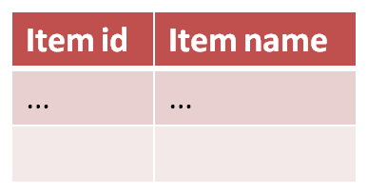
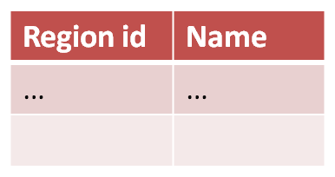
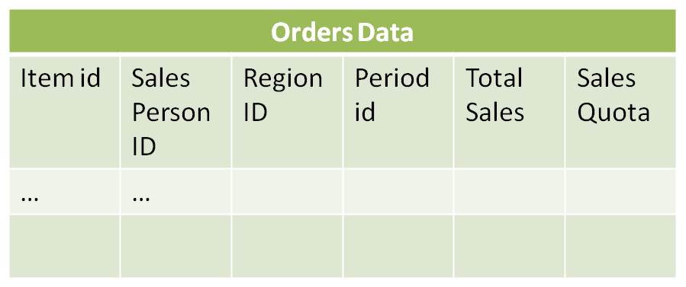
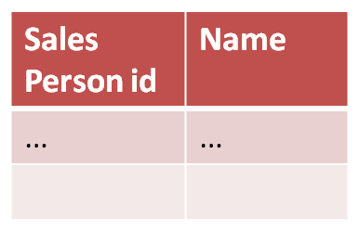
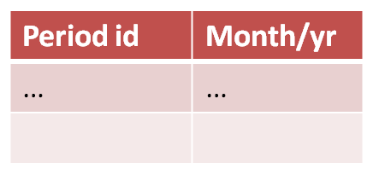
DW Structure: Star Schema (a.k.a. Dimensional Modeling)

Slide 84
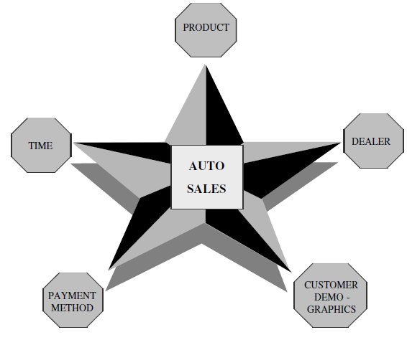
Star Schema – Auto Sales

Slide 85
Sales Application
time
time_key
day
day_of_the_week
month
quarter
year
item
item_key
item_name
brand
type
supplier_type
Sales Fact Table
time_key
item_key
branch_key
branch
location
location_key
branch_key
branch_name
branch_type
location_key
street
city
state_or_province
country
units_sold
dollars_sold
avg_sales
Measures

Slide 86
Data Mining

Slide 87
Learning Objectives
Understand the concept of Data Mining
Understand the process of gathering, selecting, cleansing, and otherwise preparing the data for mining
Understand the outputs of data mining
Learn to evaluate the effectiveness of various data mining models
Understand the CRISP-DM data mining process
Understand at a high level the range of data mining techniques, and where they are most valuable.
Appreciate the wide range of toolsets available for data mining, and their respective strengths
Become sensitive to the best practices, mistakes, and myths of data mining

Slide 88
What is Data Mining?
Data mining is the art and science of discovering knowledge, insights and patterns in data.
Predicting winning chances of a sports team
Identifying friends and foes in warfare
Forecasting rainfall patterns in a country or region
Patterns must be valid, novel, potentially useful, understandable
E.g. “customers who buy cheese and milk also buy bread 90% of the time”
Similarly, “people with blood pressure greater than 160 and an age greater than 65 were at a high risk of dying from a heart stroke” is of great diagnostic value for doctors, who can then focus on treating such patients with urgent care and great sensitivity.

Slide 89
Contd.
Data mining (knowledge discovery from data)
Extraction of interesting (non-trivial, implicit, previously unknown and potentially useful) patterns or knowledge from huge amount of data
Data mining: a misnomer?
Alternative names
Knowledge discovery (mining) in databases (KDD), knowledge extraction, data/pattern analysis, data archeology, data dredging, information harvesting, business intelligence, etc.
Watch out: Is everything “data mining”?
Simple search and query processing
(Deductive) expert systems

Slide 90
Why DM?
Recognition of hidden value in data
Field developed to help in science and defense
Evolved to help develop competitive advantage in business, fast, and at a global scale
Ability to effectively gather quality data and efficiently process it
Availability of vast amounts of data on customers, vendors, transactions, Web, machines, etc
Technologies for consolidation and integration of data sources into data warehouses
Exponential increase in computing and storage capabilities, and exponential decrease in costs

Slide 91
Gathering and Selecting Data
The total amount of data in the world is doubling every 18 months.
There is an ever-growing avalanche of data coming with higher velocity, volume, and variety. One has to quickly use it or lose it.
To learn from data, one needs to effectively gather quality data, clean and organize it, and then efficiently process it.
Enterprise Data Model (EDM) - is a unified, high-level model of all the data stored in an organization’s databases.
Gathering and curating data takes time and effort, particularly when it is unstructured or semistructured. Unstructured data can come in many forms like databases, blogs, images, videos, and chats.

Slide 92
Knowledge Discovery (KDD) Process
Knowledge
Pattern Evaluation
Data Mining
patterns
Task-relevant Data
Data Warehouse
Selection
Data Cleaning
Data Integration
Flat files
Databases

Slide 93
Data Cleansing and Preparation
The quality of data is critical to the success and value of the data mining project.
Otherwise, the situation will be of the kind of garbage in and garbage out (GIGO).
Duplicate data needs to be removed
Missing values need to be filled in
Data elements may need to be transformed from one unit to another
Continuous values may need to be binned
Data elements may need to be adjusted to make them comparable over time.

Slide 94
Contd.
Outlier data elements need to be removed
Data should be brought to the same granularity to ensure comparability.
Data may need to be selected to increase information density

Slide 95
Outputs of Data Mining
Decision tree - can be mapped to business rules
Cluster analysis output – population centroid
“middle-aged, highly educated, high-net worth professionals, married with two children, living in the coastal areas”
“20-something, ivy-league educated, tech entrepreneurs based in Silicon Valley”.
“vehicles more than 20 years old, giving low mileage per gallon, which failed the environmental inspection”.

Slide 96
Evaluating Data Mining Results
Supervised learning: classification is seen as supervised learning from examples.
Supervision: The data (observations, measurements, etc.) are labeled with pre-defined classes. It is like that a “teacher” gives the classes.
Test data are classified into these classes too, and predictive accuracy is checked.
A common metric for all of classification techniques is predictive accuracy.
Predictive Accuracy = (Correct Predictions) / Total Predictions
Unsupervised learning: e.g. clustering
Class labels of the data are unknown
Given a set of data, the task is to establish the existence of classes or clusters in the data

Slide 97
Learning Phase: Model Construction
Classification
Algorithms
Training
Data
Classifier
(Model)
IF age = ‘young’
THEN loan_dec = ‘risky’
IF income = ‘high’
THEN loan_dec = ‘safe’ …..

Slide 98
Prediction Phase
To test the classifier accuracy
Classification
rules
Testing
Data
Unseen Data
(Jeff, middle_aged, low)
RISKY

Slide 99
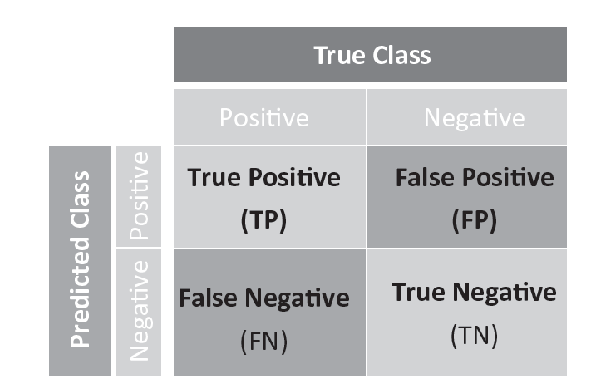
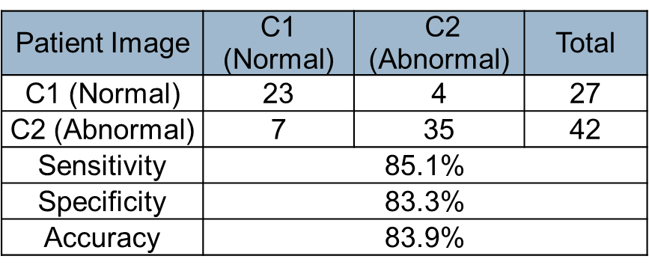
Confusion Matrix
Predictive Accuracy = (TP + TN) / (TP + TN + FP + FN).

Slide 100
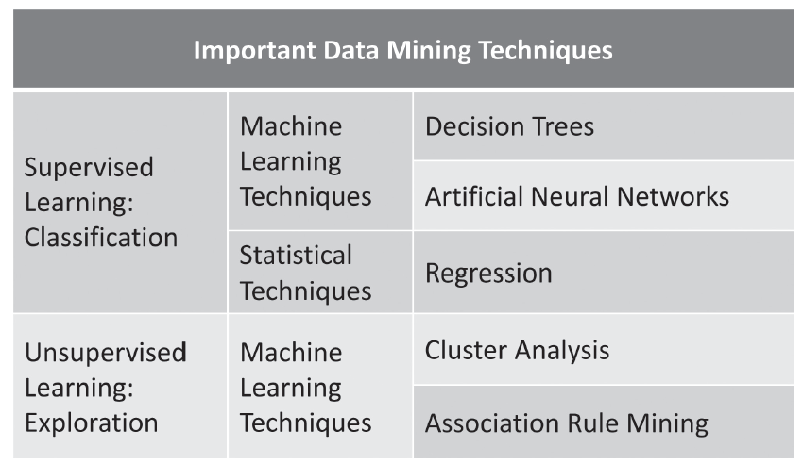
Data Mining Techniques

Slide 101
Decision Trees
Decision trees are easy to understand and easy to use, by analysts as well as executives. They also show a high predictive accuracy.
They select the most relevant variables automatically out of all the available variables for decision-making.
Decision trees are tolerant of data quality issues and do not require much data preparation from the users.
Even nonlinear relationships can be handled well by decision trees.

Slide 102
Other Methods
ANN
Cluster Analysis
Association Rule Mining
Note: will be discussed in detail later (Module-4)

Slide 103
Data Preparation – A Critical Task
Quality of data is key to data mining effectiveness
Breadth of data
Structure / Schema
Sparse /Missing values
Information density
Extract, Transform, Load (ETL) process
Scripts for automation
From operational to Dare Warehouses

Slide 104
Data in Data Mining
Data: a collection of facts usually obtained as the result of experiences, observations, or experiments
Data may consist of numbers, words, images, …
Data: lowest level of abstraction (from which information and knowledge are derived)

Slide 105
Comparing Popular DM Platforms
Feature | Excel | R | IBM SPSS Modeler | Weka
Ownership | Commercial | Open-Source | Commercial, expensive | Open-source, free
Data Mining Features | Limited; extensible with add-on modules | Extensive features, unlimited data sizes | Extensive features, unlimited data sizes | Extensive, performance issues with large data
Stand-alone | Stand-alone | Stand-alone | Embedded in BI software suites | Stand-alone
User skills needed | End-users | Skilled data miners | For skilled BI analysts | Skilled BI analysts
User interface | Text and click, Easy | Command line and IDE | Drag & Drop use, colorful, beautiful GUI | GUI, mostly b&w text output
Data formats | Industry-standard | CSV | Variety of data sources accepted | CSV, Proprietary

Slide 106
Data Mining Best Practices
Effective and successful use of data mining activity requires business and technology skills.
Business aspects - to understand the domain and the key questions. And find possible relationships in the data and create hypotheses to test it.
The IT aspects - fetch the data from many sources, clean up the data, assemble it to meet the needs of the business problem. Then run the data mining techniques on the platform.

Slide 107
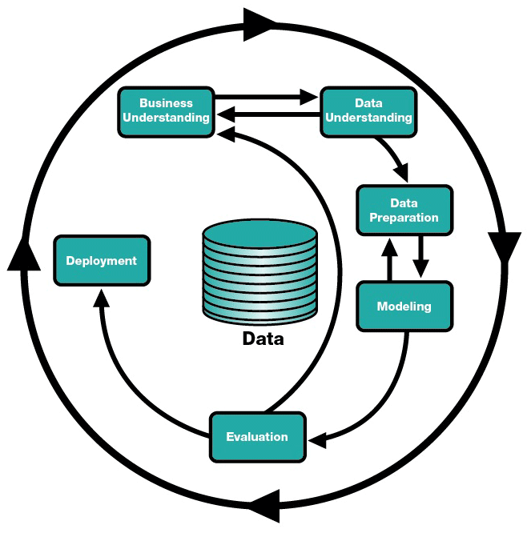
Cross-Industry Standard Process for Data Mining (CRISP-DM)
Steps
Understand the application domain
Identify data sources and select target data
Pre-process: cleaning, attribute selection
Data mining to extract patterns or models
Post-process: identifying interesting or useful patterns
Incorporate patterns in real world tasks

Slide 108
Data Mining : Myths
Data mining …
provides instant solutions/predictions
is not yet viable for business applications
requires a separate, dedicated database
can only be done by those with advanced degrees
is only for large firms that have lots of customer data
is another name for the good-old statistics

Slide 109
Data Mining: Common Mistakes
Selecting the wrong problem for data mining
Ignoring what your sponsor thinks data mining is and what it really can/cannot do
Not leaving insufficient time for data acquisition, selection and preparation
Looking only at aggregated results and not at individual records/predictions
Being sloppy about keeping track of the data mining procedure and results

Slide 110
Data Mining: Common Mistakes
Ignoring suspicious (good or bad) findings and quickly moving on
Running mining algorithms repeatedly and blindly, without thinking about the next stage
Naively believing everything you are told about the data
Naively believing everything you are told about your own data mining analysis
Measuring your results differently from the way your sponsor measures them

Slide 111
Data Visualization

Slide 112
Learning Objectives
Understand the concept of Data Visualization, and its critical role in decision-making
Understand the key rules for effective visualization
Understand the type and range of graphic devices available
Appreciate the step-by-step process of telling a story with data visualizations
Learn a few key tips to help the client understand the story better

Slide 113
Visualization
Visualization is the conversion of data into a visual or tabular format so that the characteristics of the data and the relationships among data items or attributes can be analyzed or reported.
Visualization of data is one of the most powerful and appealing techniques for data exploration.
Humans have a well developed ability to analyze large amounts of information that is presented visually
Can detect general patterns and trends
Can detect outliers and unusual patterns

Slide 114
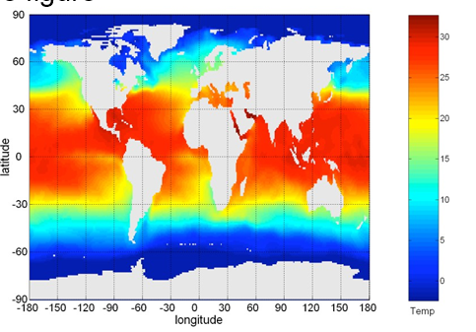
Example: Sea Surface Temperature
The following shows the Sea Surface Temperature (SST) for July 1982
– Tens of thousands of data points are summarized in a single figure

Slide 115
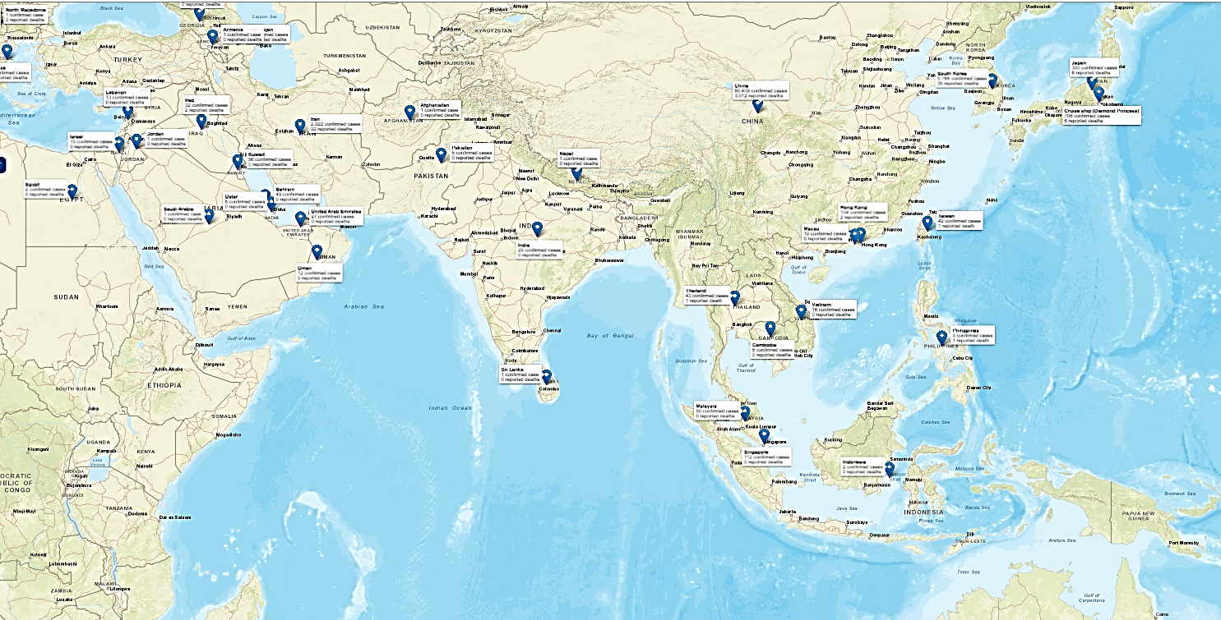
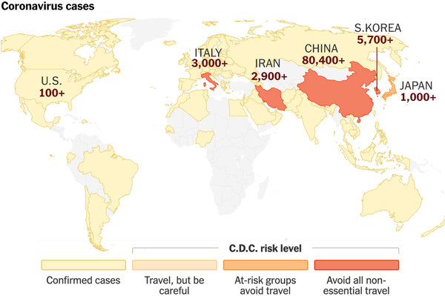
Novel Coronavirus 2019

Slide 116
Hans Rosling: Master of Data Visualizations
TED talk on Public health and longevity
https://www.youtube.com/watch?v=hVimVzgtD6w

Slide 117
Principles of Excellence in Visualization
Show, even reveal, the data
Induce viewer to think of the substance of data
Avoid distorting what the data have to say
Make large data sets coherent
Encourage eyes to compare different pieces of data
Reveal the data at several levels of detail
Serve a reasonably clear purpose
Closely integrate with the statistical and verbal descriptions of the dataset

Slide 118
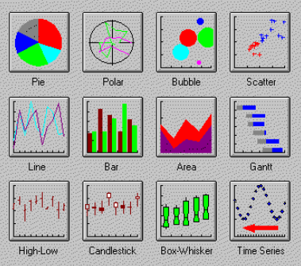
Major Types of Charts

Slide 119

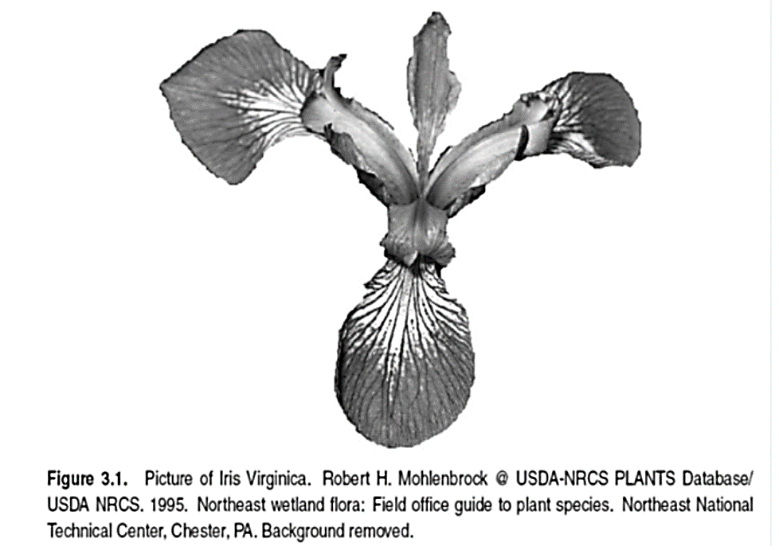
The Iris Data Set
UCI web site
150 Iris flowers
50 each from Iris species : Setosa, Versicolour, and Virginica
5 attributes
Sepal length
Sepal width
Petal length
Petal width
Class label

Slide 120
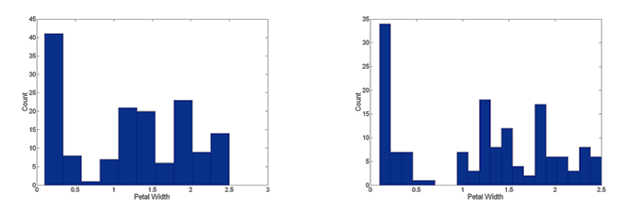
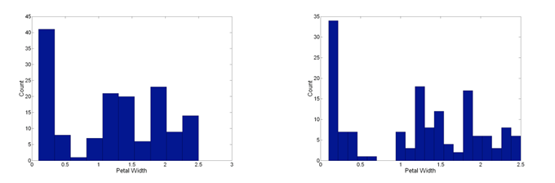
Visualization Techniques: Histograms
Histogram
Usually shows the distribution of values of a single variable
Divide the values into bins and show a bar plot of the number of objects in each bin.
The height of each bar indicates the number of objects
Shape of histogram depends on the number of bins
Example: Petal Width (10 and 20 bins, respectively)

Slide 121
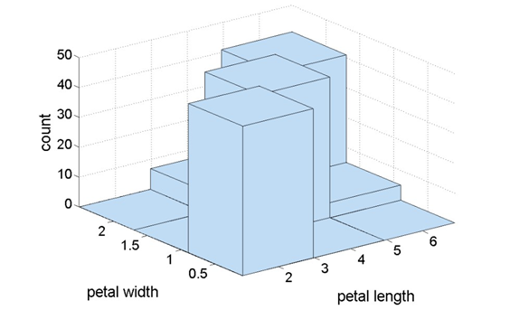
Two-Dimensional Histograms
Show the joint distribution of the values of two attributes
Example: petal width and petal length
What does this tell us?

Slide 122
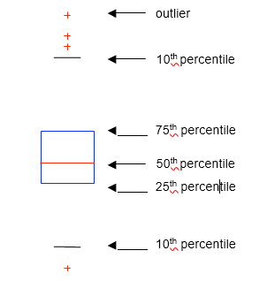
Visualization Techniques: Box Plots
Box Plots
Invented by J. Tukey
Another way of displaying the distribution of data
Following figure shows the basic part of a box plot

Slide 123
What is Percentile?
43, 54, 56, 61, 62, 66, 68, 69, 69, 70, 71, 72, 77, 78, 79, 85, 87, 88, 89, 93, 95, 96, 98, 99, 99 = 25 data values
90th percentile = 90% ∗ 25 = 0.90 ∗ 25 = 22.5 index = 23
23rd value in the data set is 98 = 90th percentile
10th percentile = 10% ∗ 25 = 0.10 ∗ 25 = 2.5 index = 3
3rd value in the data set is 56 = 10th percentile

Slide 124
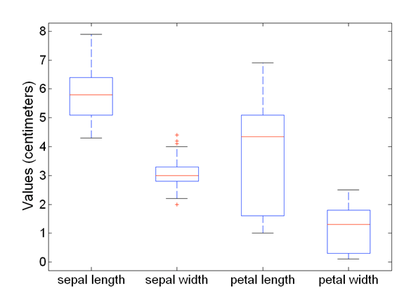
Example
Box plots can be used to compare attributes
https://youtu.be/CoVf1jLxgj4

Slide 125
Visualization Techniques: Scatter Plots
Scatter plots
Attributes values determine the position
Two-dimensional scatter plots most common, but can have three-dimensional scatter plots
Often additional attributes can be displayed by using the size, shape, and color of the markers that represent the objects
It is useful to have arrays of scatter plots can compactly summarize the relationships of several pairs of attributes

Slide 126
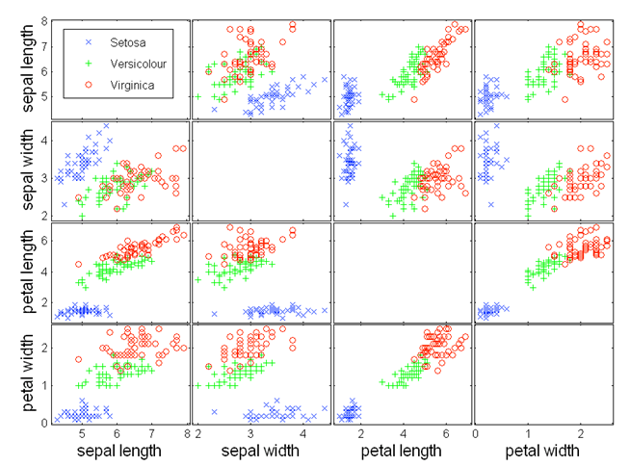
Scatter Plot Array of Iris Attributes

Slide 127
Visualization Techniques: Contour Plots
Contour plots
Useful when a continuous attribute is measured on a spatial grid
They partition the plane into regions of similar values
The contour lines that form the boundaries of these regions connect points with equal values
The most common example is contour maps of elevation
Can also display temperature, rainfall, air pressure, etc.
An example for Sea Surface Temperature (SST) is provided on the next slide

Slide 128
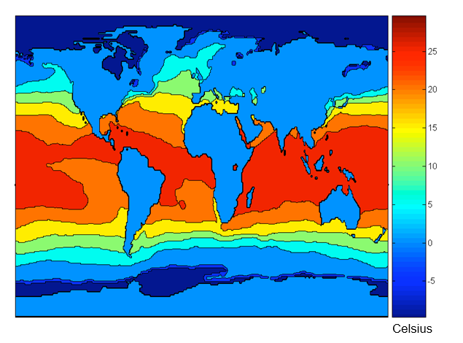
Contour Plot Example: SST Dec, 1998

Slide 129
Visualization Techniques: Matrix Plots
Matrix plots
Can plot the data matrix
This can be useful when objects are sorted according to class
Typically, the attributes are normalized to prevent one attribute from dominating the plot
Plots of similarity or distance matrices can also be useful for visualizing the relationships between objects
Examples of matrix plots are presented on the next two slides

Slide 130
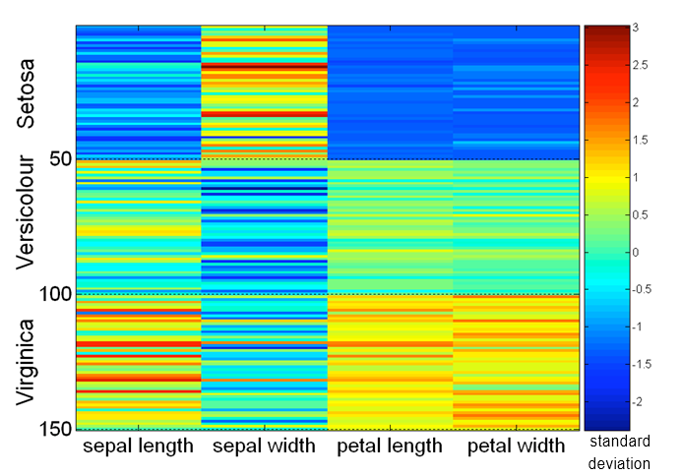
Visualization of the Iris Data Matrix

Slide 131
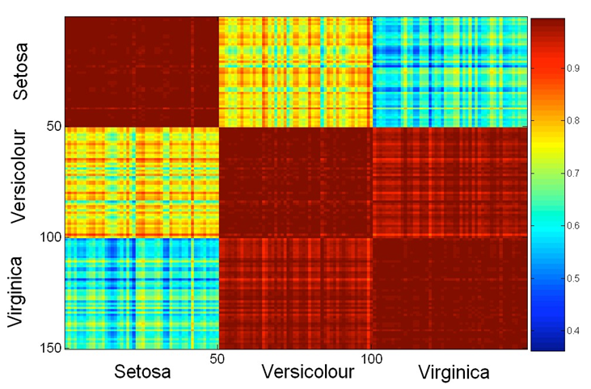
Visualization of the Iris Correlation Matrix

Slide 132
Visualization Techniques: Parallel Coordinates
Parallel Coordinates
Used to plot the attribute values of high-dimensional data
Instead of using perpendicular axes, use a set of parallel axes
The attribute values of each object are plotted as a point on each corresponding coordinate axis and the points are connected by a line
Thus, each object is represented as a line
Often, the lines representing a distinct class of objects group together, at least for some attributes
Ordering of attributes is important in seeing such groupings

Slide 133
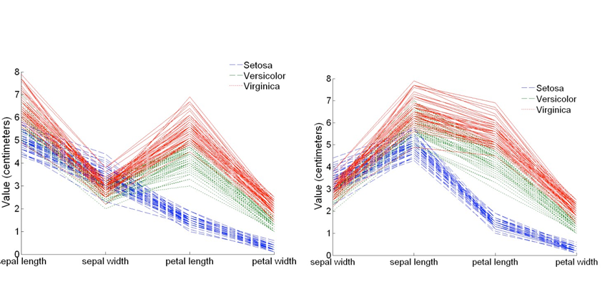
Parallel Coordinates Plots for Iris Data

Slide 134
Major chart types
Line graph: points connected by line segments.
Scatter plot: relationship between two variables.
Bar graph: colorful rectangular bars proportional to values (also stacked-bar and histograms)
Pie charts: size of a slice represents relative value.
Box charts: central value and range
Bubble graphs: New form; more dimensions
Dials: quick color reference (red-yellow-green)
Pictographs – using representative pictures to display objects and values

Slide 135
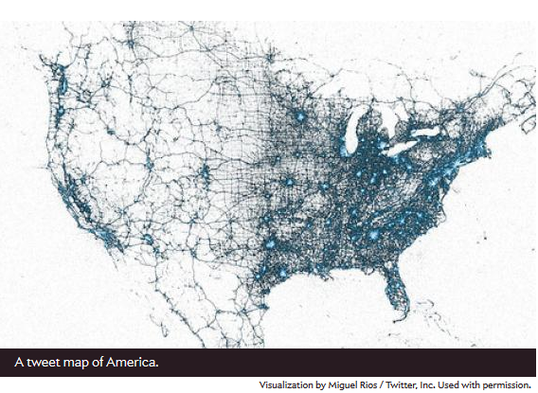
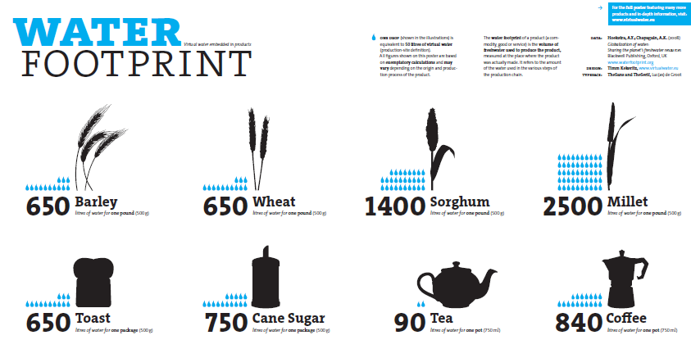
Pictograph examples
Twitter origination density
Water footprint for products

Slide 136
Business Data Visualization … Step 1: Enhancing & Organizing the data
Base Data Table
Product | Revenue | Orders | SalesPers
AA | 9731 | 131 | 23
BB | 355 | 43 | 8
CC | 992 | 32 | 6
DD | 125 | 31 | 4
EE | 933 | 30 | 7
FF | 676 | 35 | 6
GG | 1411 | 128 | 13
HH | 5116 | 132 | 38
JJ | 215 | 7 | 2
KK | 3833 | 122 | 50
LL | 1348 | 15 | 7
MM | 1201 | 28 | 13
Product | Revenue | Orders | SalesPers | Rev/Order | Rev/SalesP | Orders/SalsP
AA | 9731 | 131 | 23 | 74.3 | 423.1 | 5.7
HH | 5116 | 132 | 38 | 38.8 | 134.6 | 3.5
KK | 3833 | 122 | 50 | 31.4 | 76.7 | 2.4
GG | 1411 | 128 | 13 | 11.0 | 108.5 | 9.8
LL | 1348 | 15 | 7 | 89.9 | 192.6 | 2.1
MM | 1201 | 28 | 13 | 42.9 | 92.4 | 2.2
CC | 992 | 32 | 6 | 31.0 | 165.3 | 5.3
EE | 933 | 30 | 7 | 31.1 | 133.3 | 4.3
FF | 676 | 35 | 6 | 19.3 | 112.7 | 5.8
BB | 355 | 43 | 8 | 8.3 | 44.4 | 5.4
JJ | 215 | 7 | 2 | 30.7 | 107.5 | 3.5
DD | 125 | 31 | 4 | 4.0 | 31.3 | 7.8
Total | 25936 | 734 | 177 | 35.3 | 146.5 | 4.1

Slide 137
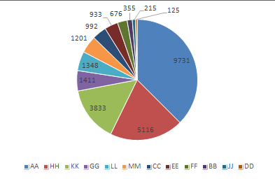
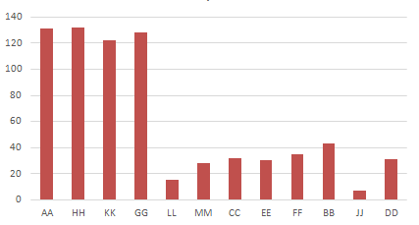
Business Data Visualization … Step 2: Product performance … sorted by revenue
Revenue by Products
Orders by Products

Slide 138
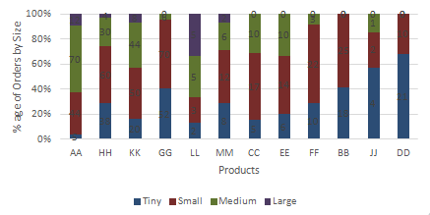
Business Data Visualization … Step 3: Product performance … drill down

Slide 139
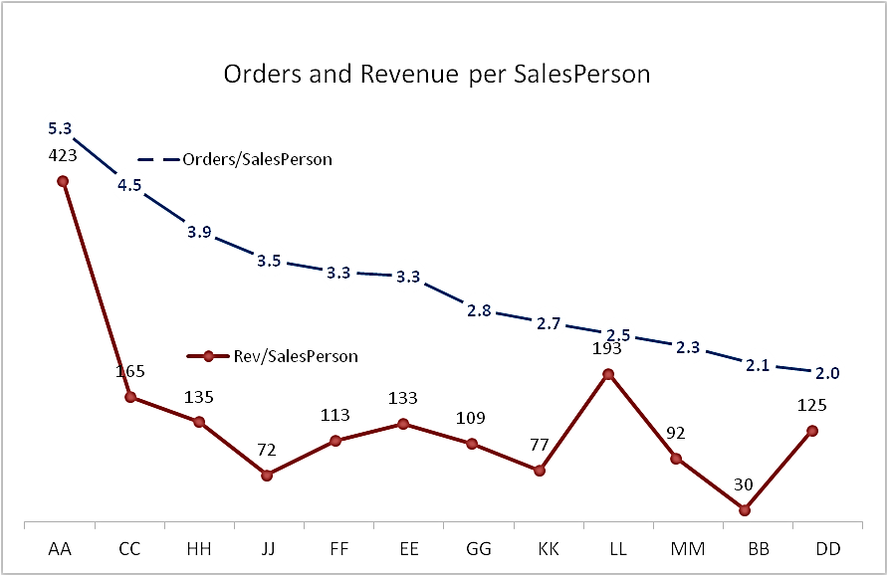
Business Data Visualization … Step 4: SalesPerson performance

Slide 140
Tips for Great Visualizations
Fetch appropriate and correct data for analysis.
Sort the data in the most appropriate manner.
Choose appropriate method to present the data.
The data set could be pruned
The visualization could show additional dimension for reference
The numerical data may need to be binned into a few categories.
High-level visualization could be backed by more detailed analysis.
There may be need to present additional textual information to tell the whole story.

Slide 141
Summary

